Slide 1




SOUTHERN VANCOUVER ISLAND LITERACY PROFILES
CHILDREN AND YOUTH
LITERACY TYPES
Click here to discover different types of literacy
Click here for children and youth literacy profiles
(ages 0-24)
ADULTS
WHO IS AT RISK?
Click here to find out about groups of people who might be at risk of low literacy
Click here for adult literacy profiles (ages 25-64)
PIAAC
OLDER ADULTS
Click here to find out about the Programme for the International Assessment of adult competencies (PIAAC)
Click here for older adult literacy profiles (ages 65+)

Slide 2






Literacy Types
TRADITIONAL LITERACY
Literacy is the ability to identify, understand, interpret, create, communicate and compute, using printed and written materials associated with varying contexts. Literacy involves a continuum of learning in enabling
individuals to achieve their goals, to develop their knowledge
and potential, and to participate fully in their community and
wider society
MEDIA LITERACY
Media literacy is developing an understand understanding of the functions of media and other information providers, to critically evaluate their content, and make informed decisions as users and producers of information and media content
DIGITAL LITERACY
Digital literacy is the ability to define, access, manage, integrate, communicate, evaluate and create information safely and appropriately through digital technologies and networked devices for participation in economic and social life
UNESCO MEDIA LITERACY 🡪 http://www.unesco.org/new/en/communication-and-information/media-development/media-literacy/mil-as-composite-concept/
UNESCO DEFINITIONS🡪 http://gaml.uis.unesco.org/wp-content/uploads/sites/2/2018/12/4.6.1_07_4.6-defining-literacy.pdf

Slide 3

Who is at Risk?
In Canada, some groups that are likely to experience literacy challenges include:
Canadians with fewer years of schooling
Immigrants
Indigenous Peoples
Older Canadians
      (Decoda Literacy Matters Fact Sheet, 2018)
Immigrants are the most at risk of low literacy proficiency scores if they arrive in Canada at an older age, do not speak an official language in Canada and have low levels of education
  (PIAAC 2012, Immigrants in Canada)
In Canada, Indigenous peoples score lower on literacy, numeracy and problem-solving in technology rich environments compared to the non-Indigenous population. The health and social outcomes of these results should be interpreted in the context of ongoing social, cultural and economic marginalization, including the implications of colonization.
(PIAAC 2012, Executive Summary)
PIAAC 2012, Executive Summary 🡪 http://www.piaac.ca/docs/PIAAC2018/PIAAC-HS-Outcomes_Executive-Summary_EN.pdf
PIAAC 2012, Immigrants in Canada 🡪 http://www.piaac.ca/docs/PIAAC%202012%20Immigrants%20Canada%20Final%20EN.pdf
Decoda Literacy Matters 🡪 https://www.decoda.ca/wp-content/uploads/Literacy-Matters-Fact-Sheet_August-2018.pdf

Slide 4
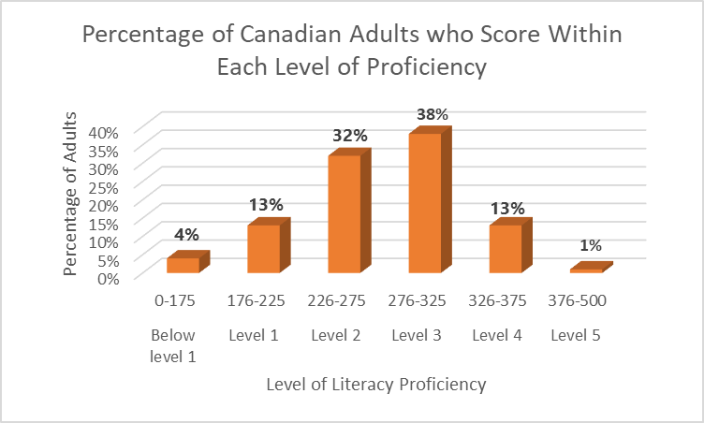
The Programme for the International Assessment of Adult Competencies (PIAAC)
PIAAC is a survey of adults aged 16-65 that assesses skills in literacy, numeracy and problem-solving in technology-rich environments.
4% of Canadians score below level 1 and can only interpret brief written texts on familiar topics to locate a single piece of information.
13% of Canadians score at level 1 and can locate single pieces of information in short written texts in the absence of distracting information.
For more information about PIAAC literacy levels 🡪 https://www150.statcan.gc.ca/n1/pub/89-555-x/2013001/t/tbl1.1-eng.htm
Click here for more information 🡪 https://www150.statcan.gc.ca/n1/pub/89-555-x/2013001/chap1-eng.htm

Slide 5
Children and Youth Literacy Profiles
Learning Differences
Newcomers and English Language Learners (ELL)
Families
Indigenous Children and Youth
Community Programs and Services

Slide 6
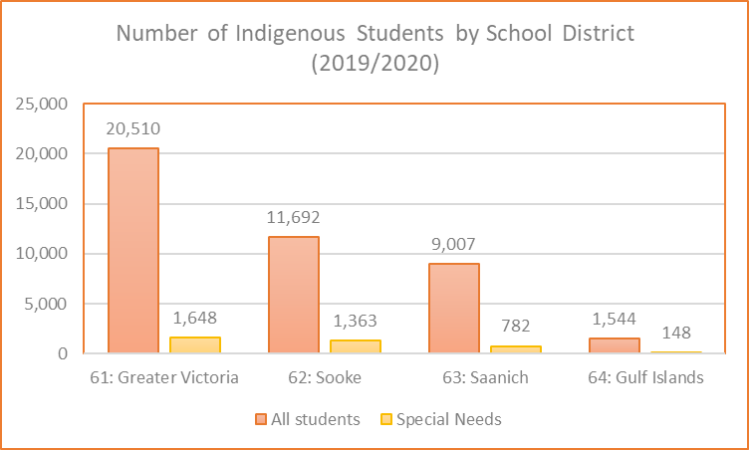
Indigenous Children and Youth 1
Indigenous students are students that self-identify as being of Indigenous ancestry (First Nations: Status or non-status, Métis and Inuit).
There are 3,941 students from kindergarten to grade 12 who identified as Indigenous in the 2019-2020 school year for School Districts 61 (Greater Victoria ,62 (Sooke), 63 (Saanich) and 64 (The Gulf Islands).
Click here for school district 61 contextual information (See references for additional school district links) 🡪 https://studentsuccess.gov.bc.ca/school-district/061
Aboriginal Reports How are we Doing? 🡪 https://www2.gov.bc.ca/gov/content/education-training/k-12/administration/program-management/reporting-on-k-12/aboriginal-report

Slide 7
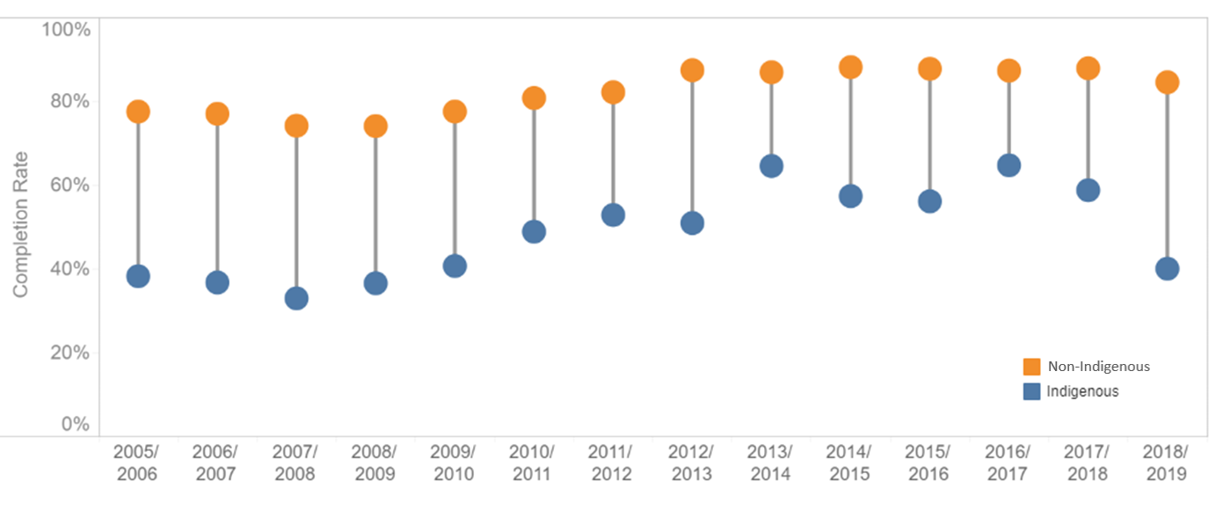
Indigenous Children and Youth 2
High school Completion Rates of Indigenous Students and Non-Indigenous Students
over time in the Greater Victoria School District (61)
Only 65-76% of Indigenous students in BC graduate from high school compared to 76%-86% for non-indigenous students
From 2005-2019, indigenous students had low rates of completion from the Greater Victoria School District (33%-65%)
NOTE: This table was modified to change the term “BC residents” to “Non-Indigenous”
Click here for school district 61 completion rates 🡪 https://studentsuccess.gov.bc.ca/school-district/061/report/completion-rates

Slide 8
Newcomers and English as an Additional Language 1
The age of arrival to Canada is important for literacy proficiency. There is a link between younger age of arrival to Canada and higher literacy proficiency. Children that arrive to Canada before age 6 have higher proficiency scores than those that arrive between ages 6-12. Children who arrive after age 12 have the lowest proficiency scores.
For recent immigrants to British Columbia who do not speak English as a first or additional language, lower proficiency with the English language overall can lead to challenges with reading and writing, specifically. These literacy challenges faced by some newcomers may be even more pronounced than for those who speak English with fluency and accuracy."
Children who arrive in a new country at an older age (12+) will have more difficulty with reading proficiency than children who arrive earlier
Children who are recent immigrants or speak a minority language at home have more difficulty with understanding written text but are better at spelling and decoding words.
Click here for more information 🡪 https://www.oecd.org/education/Helping-immigrant-students-to-succeed-at-school-and-beyond.pdf
Click here for more information 🡪 https://journals.sagepub.com/doi/abs/10.1080/10862960903340165

Slide 9

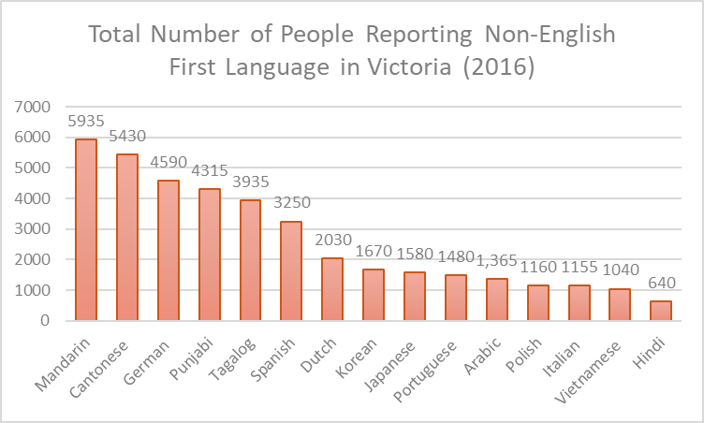

Newcomers and English as an Additional Language 2
The 2016 Canadian census indicates the number of people living in Victoria who reported a first language other than English or French. Indigenous languages in Canada are reported on a separate document.
The bar graph on the left shows the languages with the greatest number of speakers living in the Victoria Metropolitan Area in 2016. Please note that there are many more languages with fewer speakers than shown here
Altogether, 51,905 people in Victoria reported a language other than English as their first language in 2016. That is, 14.3% of the population.
For a complete list of languages in Victoria 🡪 https://www12.statcan.gc.ca/census-recensement/2016/dp-pd/dv-vd/lang/index-eng.cfm

Slide 10
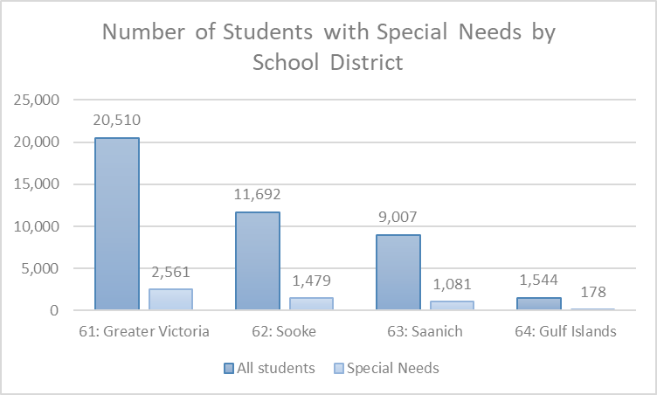
Children and Youth with Learning Differences
Children with learning differences are more likely than children without learning differences to have low levels of literacy
There are 5,299 K-12 students with “special needs” in School Districts 61, 62, 63, and 64 in the 2019/2020 school year
The term “special needs” as it is used by school districts can include a range of strengths and weaknesses and does not necessarily point to low literacy skills.
However, learning differences frequently co-occur with other types of special needs.
Click on the links for contextual information by school district🡪 https://studentsuccess.gov.bc.ca/school-district/061/report/contextual-information

Slide 11
Families with Children
The Programme for International Student Assessment (PISA) is a survey of 15-year old students which assesses key knowledge and skills such as reading, math and knowledge in relation to overall well-being
In Canada, students who belong to families with higher socio-economic status outperform students who belong to families with lower socio-economic status by an average 68 points on reading assessments (PISA, 2018)
24% of students from high socio-economic households and 7% of students from low socio-economic households were top performers in reading
However, lower performance in reading is not an absolute outcome for students who live in low socio-economic households. 14% of students living in low socio-economic households scored in the top quarter of reading performance within Canada.
Click here for more information 🡪 https://www.oecd.org/pisa/publications/PISA2018_CN_CAN.pdf

Slide 12
Southern Vancouver Island Literacy Programs and Services
Children and Youth
VICTORIA AND SAANICH
WESTSHORE AND SOOKE
Click here for Programs and Services in the Westshore
Click here for programs in the Victoria/Saanich region
02
03
SAANICH PENINSULA
01
GULF ISLANDS
04
Click here for programs and services in the Saanich Peninsula
Click here for programs and services in the Gulf Islands

Slide 13

Victoria and Saanich Literacy Programs and Services
Children and Youth
Ages 0-5
Greater Victoria Regional Library/ Vancouver Island Regional Library
Story Studio
Story Theater Productions Society
EARLY CHILDHOOD
Ages6-12
Greater Victoria Regional Library/ Vancouver Island Regional Library
Story Studio
Story Theater Productions Society
ArtsREACH
Victoria Literacy Connection
LDABC The Learning Curve
CHILDHOOD
YOUTH
Ages 13-24
Greater Victoria Regional Library/
Vancouver Island Regional Library
Story Studio
Intercultural Association of Greater Victoria
School of Access: Camosun College
Victoria Literacy Connection
LDABC The Learning Curve

Slide 14
Saanich Peninsula Literacy Programs and Services
Children and Youth
Ages 0-5
Greater Victoria Regional Library Vancouver Island Regional Library
Story Studio
Story Theater Productions Society
EARLY CHILDHOOD
Ages6-12
Greater Victoria Regional Library/ Vancouver Island Regional Library
Story Studio
Story Theater Productions Society
ArtsREACH
Victoria Literacy Connection
LDABC The Learning Curve
CHILDHOOD
YOUTH
Ages 13-24
Greater Victoria Regional Library/
Vancouver Island Regional Library
Story Studio
Intercultural Association of Greater Victoria
School of Access: Camosun College
Victoria Literacy Connection
LDABC The Learning Curve

Slide 15
Westshore and Sooke Literacy Programs and Services
Children and Youth
Ages 0-5
Greater Victoria Regional Library/
Vancouver Island Regional Library
Story Studio
Story Theater Production Society
Westshore Literacy
EARLY CHILDHOOD
Ages6-12
Greater Victoria Regional Library/ Vancouver Island Regional Library
Story Studio
Story Theater Production Society
ArtsREACH
Victoria Literacy Connection
LDABC The Learning Curve
Westshore Literacy
CHILDHOOD
YOUTH
Ages 13-24
Greater Victoria Regional Library/
Vancouver Island Regional Library
Story Studio
Intercultural Association of Greater Victoria
School of Access: Camosun College
Victoria Literacy Connection
LDABC The Learning Curve

Slide 16
Gulf Islands Literacy Programs and Services
Children and Youth
Ages 0-5
Vancouver Island Regional Library
Story Theater Production Society
Salt Spring Literacy
EARLY CHILDHOOD
Ages6-12
Vancouver Island Regional Library
Story Theater Production Society
Salt Spring Literacy
CHILDHOOD
YOUTH
Ages 13-24
Vancouver Island Regional Library
Salt Spring Literacy

Slide 17
Adult Literacy Profiles
Learning Differences
Newcomers and English Language Learners (ELL)
Fewer years of Education
Indigenous Literacy Learners
Community Programs and Services

Slide 18
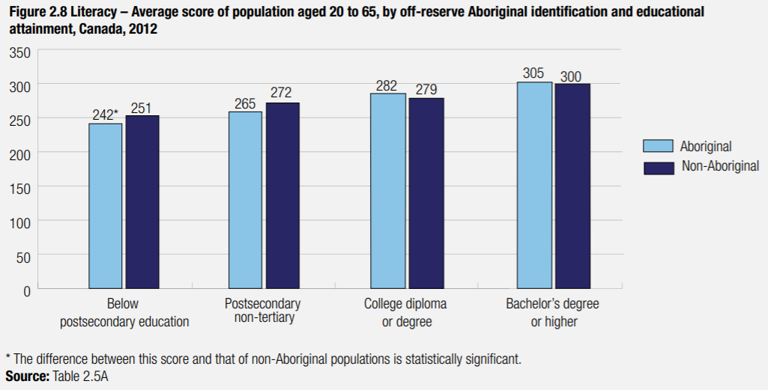
Indigenous Adult Learners
The Programme for the International Assessment of Adult Competencies (PIAAC) is a global assessment for adult skills in literacy, numeracy and problem-solving in technology-rich environments.
Literacy skill levels of Indigenous populations are lower than non-Indigenous populations in Canada.
Indigenous Canadians with all types of post-secondary education perform the same as Non-Indigenous Canadians with the same levels of education. The literacy gap disappears with higher levels of education.
Disclaimer: The data presented here does not accurately represent Indigenous populations of Canada. The Indigenous populations who participated in PIAAC were: First Nations peoples living off-reserve (48%), Métis (44%), and Inuit (5%) but did not include Indigenous peoples living on-reserve (38% of Canada’s Indigenous population).
Post-secondary non-tertiary refers to graduates of apprenticeship, trade and vocational training programs that lasted under 2 years
College Diploma or degree refers to college diplomas of over 2 years and university certificates below bachelor level
Click here for more information 🡪 http://www.cmec.ca/Publications/Lists/Publications/Attachments/362/PIAAC_PSE_CMEC_2016_EN.pdf

Slide 19
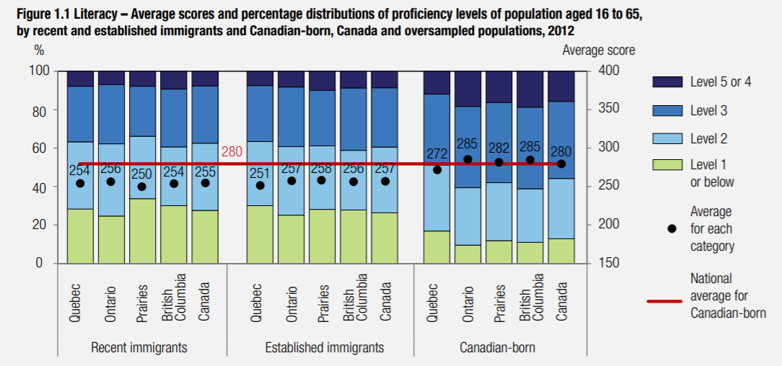
Adult Newcomers and ELL: Literacy Proficiency
The Programme for International Assessment of Adult Competencies (PIAAC) surveyed people aged 16-65 on reading, numeracy and problem-solving in technology-rich environments.
On average, recent immigrants and established immigrants aged 16-65 show lower literacy proficiency scores than people born in Canada
Recent immigrants and established immigrants had similar scores which suggests that the time spent in Canada may not have a large effect on literacy proficiency
Recent Immigrants are defined by arrival to Canada between 2002-2012
Established Immigrants are defined by arrival to Canada before 2002
Canadian-born refers to people born in Canada
Click here for more Information 🡪 http://www.piaac.ca/docs/PIAAC%202012%20Immigrants%20Canada%20Final%20EN.pdf

Slide 20
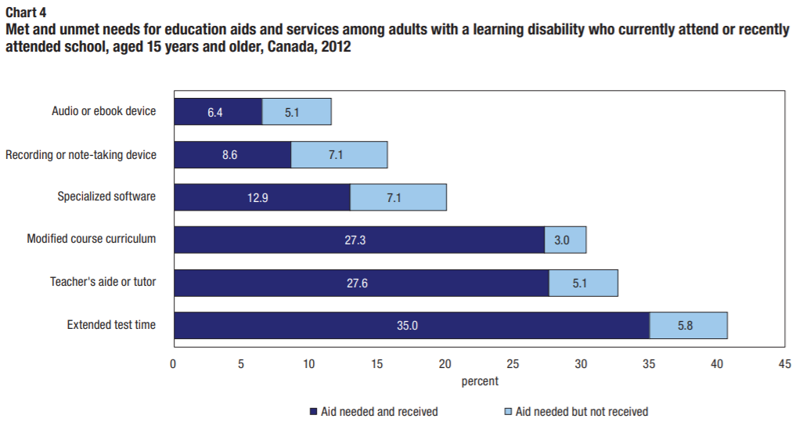
Adults with Learning Differences 1
Over half of adults who recently attended school with learning differences (age 15+) required some kind of educational aid or service
Adults with learning differences were more likely to report that they needed extended test time and teacher’s aides or tutors, which were predominantly met.
Technology-based supports were less likely to be needed but adults who did report needing them were less likely to receive them.
Click here for more information 🡪 www150.statcan.gc.ca/n1/en/pub/89-654-x/89-654-x2014003-eng.pdf?st=EBaQrzXv

Slide 21
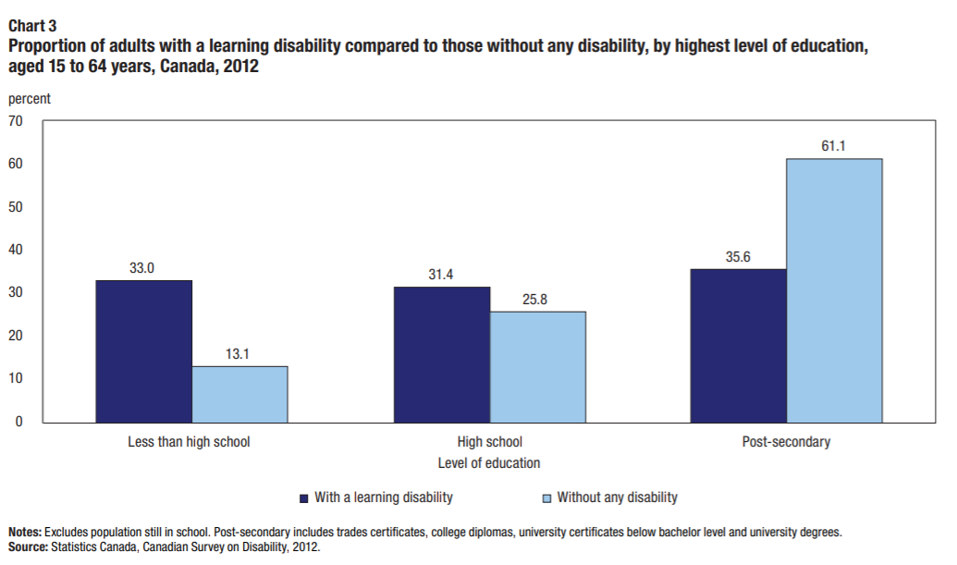
Adults with Learning Differences 2
In Canada, adults with learning differences are more likely to have overall lower rates of completing education (Stats Canada, Canadian Survey on Disabilities, 2012)
33% of adults with learning differences aged 15-65 reported not completing high school compared to 13.1% of adults without learning differences
35.6% of adults with learning differences reported completing post-secondary qualifications compared to 61.1% of adults without learning differences.
*Note: This survey only targeted adults aged 15-65 who were not currently attending school and “post-secondary education” does not include trades certificates, college degrees or university certificates below bachelor level.
Click here for more information 🡪 https://www150.statcan.gc.ca/n1/en/pub/89-654-x/89-654-x2014003-eng.pdf?st=EBaQrzXv

Slide 22
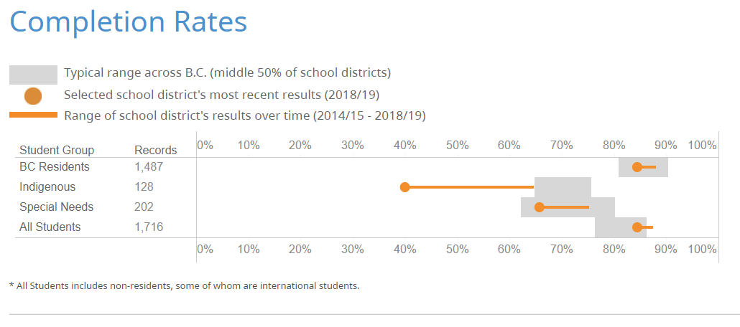
Adults with Fewer Years of Education
  Fewer years of education is a known risk factor for low levels of literacy proficiency
  In the Greater Victoria School District (61), 16% of all students did not graduate from high school in the 2018/2019 school year.
  Out of 128 Indigenous students, only 40% graduated high school and out of 202 special needs students only 66% graduated high school in 2018/2019.
This data points towards low levels of literacy proficiency for adults in Victoria who have not completed high school. However, this data should be interpreted with caution because reasons for not graduating high school vary and are not listed.
School District 61 Completion Rates (See references for other school districts) 🡪https://studentsuccess.gov.bc.ca/school-district/061/report/completion-rates

Slide 23
Southern Vancouver Island Literacy Programs and Services
Adults aged 25-64
WESTSHORE AND SOOKE
VICTORIA AND SAANICH
Click here for Programs and Services in the Westshore
Click here for programs in the Victoria/Saanich region
02
03
SAANICH PENINSULA
01
GULF ISLANDS
04
Click here for programs and services in the Saanich Peninsula
Click here for programs and services in the Gulf Islands

Slide 24
Victoria, Saanich, Saanich Peninsula, Westshore and Sooke
Literacy Programs and Services for adults aged 25-64
Intercultural Association
of Greater Victoria
Greater Victoria Public Library/ Vancouver Island Regional Library
School of Access: Camosun College
LDABC The Learning Curve
Continuing Education Programs: School Districts 61, 62, 63, 64
Victoria Literacy Connection

Slide 25
Gulf Islands Literacy Programs and Services
Adults aged 25-64
Salt Spring Literacy
Story Theater Productions Society
Vancouver Island Regional Library

Slide 26
Older Adult Profiles
Learning Differences
Newcomers and English Language Learners (ELL)
Low Digital Literacy Skills
Indigenous Older Adult Learners
Community Programs and Services

Slide 27
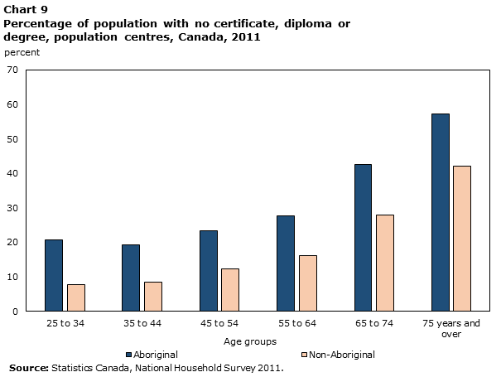
Indigenous Older Adult Learners 1 (65+)
Between 40 and 50% of Indigenous people age 65 to 74 have no certificate, diploma, or degree (Stats Canada, Aboriginal Peoples Survey, 2012)
60% of Indigenous people 75 years and older do not have a certificate, diploma, or degree
This is linked to the fact that 23% of Indigenous seniors have low income and have food insecurity
The Camosun Indigenous Advisor has worked with someone as old as 78 but most adults they work with are young adults
The Victoria Native Friendship Centre (VNFC) has some programs such as a storytelling circle and the Aboriginal Speech Language Program (which supports pre-literacy skills development). The Bruce Parisian library has a mandate to support literacy programs but they weren’t able to give any data.
Click here for more information: https://www150.statcan.gc.ca/n1/pub/89-653-x/89-653-x2017013-eng.pdf

Slide 28


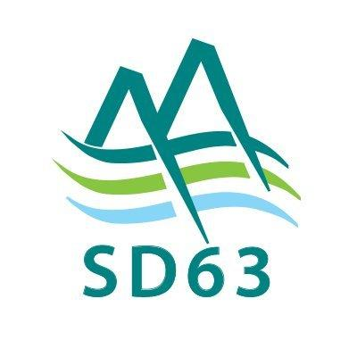
Indigenous Older Adult Learners 2
The nations and the school districts they are part of.
Songhees (SD 61)
Esquimalt (SD 61)
Tsawout (SD 63)
Tseycum (SD 63)
Pauquachin (SD 63)
Tsartlip (SD 63)
Scia'new (SD 62)
T'souke (SD 62)
Pacheedaht (SD 62)
Malahat (they are in our catchment zone as a nation, but they don't sit in the school districts I primarily work with)

Slide 29
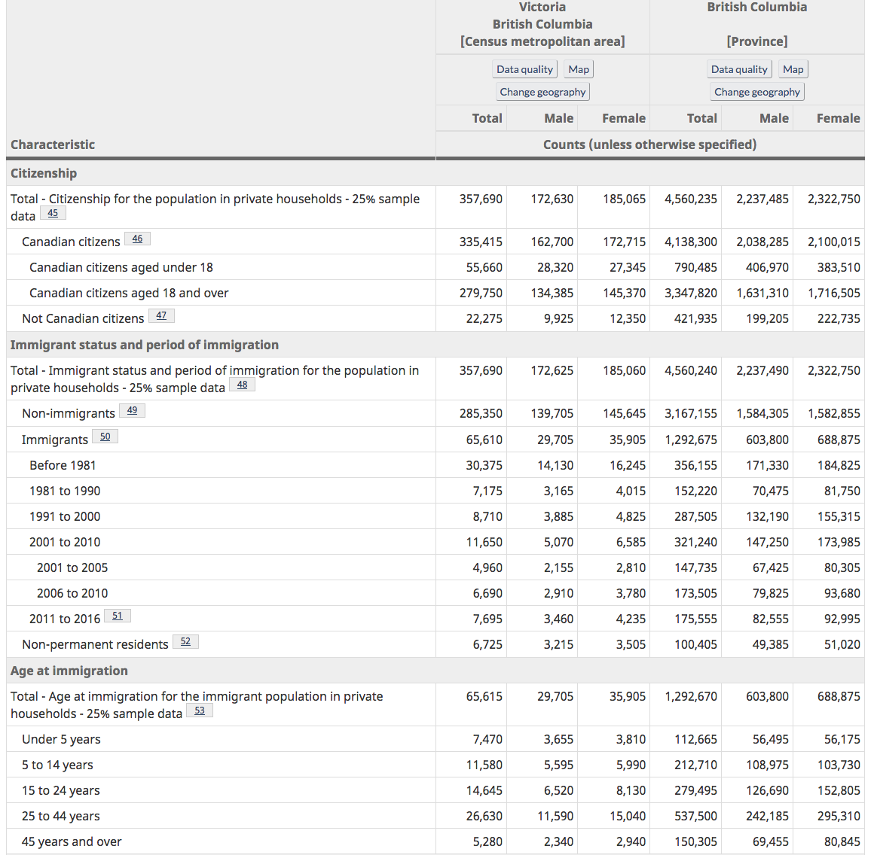
Newcomers and English Language Learners (65+)
The 2016 Census reveals that there were 5,280 immigrants over the age of 45 in Victoria in 2018
Language Instruction for Newcomers to Canada is one of the English language programs to help adult immigrants learn English. Most of their learners are between 35-55 years old but they have some as old as 80.
Another service organization is Anglican Diocese of British Columbia. They deal with private refugees, while ICA - which puts on the LINC courses - deals with government sponsored ones. 50% of the refugees they deal with are aged 50+. Close to 60% of them need literacy training, even in their own languages, but some of them come with PhDs.
Click here for more information: https://www150.statcan.gc.ca/n1/pub/75-006-x/2019001/article/00017-eng.pdf

Slide 30
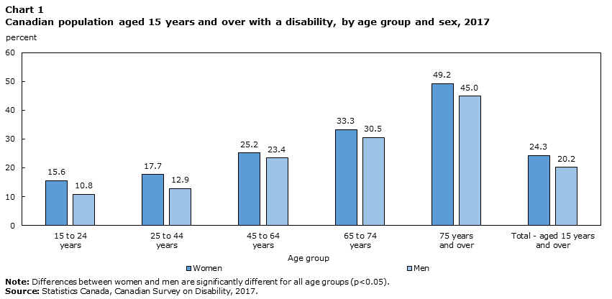
Older adults with Learning Differences
47% of older seniors (those aged 75+) had disabilities and 32% of younger seniors (those 65 to 74 years) had disabilities
This report, in addition to other Canadian Surveys on Disability, reveals that many disabilities co-occur with other types of disabilities. 35.1% of seniors 65 to 74 had 4 or more disabilities compared to 44.2% of their older counterpart.
Co-occurance of learning disabilities with others is not made clear in this version of the Survey on Disability but the 2012 version shows that physical disabilities are the most likely (96.1% in 65 and older) to co-occur in seniors.
Click here for more information 🡪 https://www150.statcan.gc.ca/n1/pub/89-654-x/89-654-x2018002-eng.pdf
https://www150.statcan.gc.ca/n1/en/pub/89-654-x/89-654-x2014003-eng.pdf?st=EBaQrzXv

Slide 31
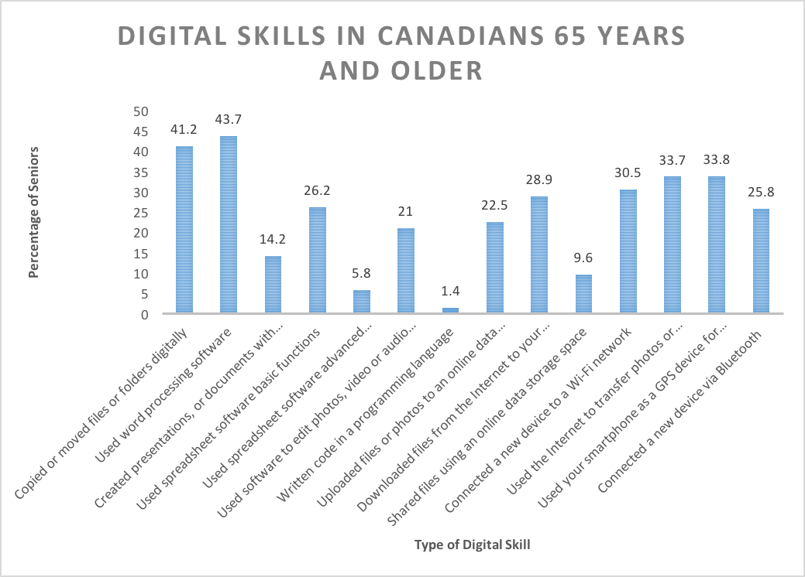

Older adult with Low Digital Literacy Skills
These are some of the activities requiring digital skills that older adults, over the age of 65, took part in during a study period of 2018-2019.
The most common digital activities of seniors did was used word processing software (43.7%), followed by copied or moved files or folders digitally (41.2%), and used your smartphone as a GPS device (33.8%).
In total, 71% of seniors used the internet in 2018.
Please note the low figure for coding may be low due to lack of data.
Click here for more information: https://www150.statcan.gc.ca/n1/en/pub/11f0019m/11f0019m2019015-eng.pdf?st=ygU1Nc3_
https://www150.statcan.gc.ca/n1/daily-quotidien/191029/dq191029a-eng.pdf data for graph is from Table 22-10-0112-01

Slide 32
Southern Vancouver Island Literacy Programs and Services
Older Adults
WESTSHORE AND SOOKE
VICTORIA AND SAANICH
Click here for Programs and Services in the Westshore
Click here for programs in the Victoria/Saanich region
02
03
SAANICH PENINSULA
01
GULF ISLANDS
04
Click here for programs and services in the Saanich Peninsula
Click here for programs and services in the Gulf Islands

Slide 33
Victoria, Saanich, Saanich Peninsula, Westshore, Sooke and Gulf Islands Literacy Programs and Services for Older Adults aged 65+
Intercultural Association
of Greater Victoria
Language Instruction for Newcomers to Canada
Victoria Immigrant and Refugee Centre Society
Greater Victoria Public Library/ Vancouver Island Regional Library
Salt Spring Literacy
School of Access: Camosun College
Collaborative Online Resources & Education: Healthy Aging CORE
Victoria Literacy Connection
Silver Threads
Seniors Serving Seniors
Adult Education Programs: School Districts 61, 62, 63, 64

Slide 34
References 1
Aboriginal Report How are we Doing? (n.d.) The Government of British Columbia. Retrieved November 2020, from https://www2.gov.bc.ca/gov/content/education-training/k-12/administration/program-management/reporting-on-k-12/aboriginal-report
August, D., Shanahan, T., & Escamilla, K. (2009). English Language Learners: Developing Literacy in Second-Language Learners—Report of the National Literacy Panel on Language-Minority Children and Youth. Journal of Literacy Research, 41(4), 432–452. https://doi.org/10.1080/10862960903340165
Bizier, C., Till, M., & Nicholls, G., (2015) Learning Disabilities among Canadians aged 15 and older in Canada. Canadian Survey on Disability, 2012. Statistics Canada Catalogue no. 89-654-X2014003 Retrieved from https://www150.statcan.gc.ca/n1/en/pub/89-654-x/89-654-x2014003-eng.pdf?st=EBaQrzXv
Chapter 1: Canada in an International Context. (2013). Statistics Canada. Statistics Canada—Catalogue no.89-555-X. Retrieved November 2020, from https://www150.statcan.gc.ca/n1/pub/89-555-x/2013001/chap1-eng.htm
Davidson, J. & Schimmele, C. (2019). Evolving Internet Use Among Canadian Seniors. Analytical Studies Branch Research Paper Series. Statistics Canada Catalogue no. 11F0019M, no. 427 Retrieved from https://www150.statcan.gc.ca/n1/en/pub/11f0019m/11f0019m2019015-eng.pdf?st=pahFVTrf
Description of Proficiency Levels (2013) Statistics Canada. Statistics Canada—Catalogue no.89-555-X. Retrieved November 2020, from https://www150.statcan.gc.ca/n1/pub/89-555-x/2013001/t/tbl1.1-eng.htm
Greater Victoria (61) Completion Rates. (n.d.) The Government of British Columbia. Retrieved November 2020, from https://studentsuccess.gov.bc.ca/school-district/061/report/completion-rates
Greater Victoria (61) Contextual Information. (n.d.) The Government of British Columbia. Retrieved November 2020 from, https://studentsuccess.gov.bc.ca/school-district/061/report/contextual-information
Gulf Islands (64) Completion Rates. (n.d.) The Government of British Columbia. Retrieved November 2020, from https://studentsuccess.gov.bc.ca/school-district/064/report/completion-rates
Gulf Islands (64) Contextual Information. (n.d.) The Government of British Columbia. Retrieved November 2020 from, https://studentsuccess.gov.bc.ca/school-district/064/report/contextual-information
Helping Immigrant Students to Succeed at School –and Beyond. (2015) OECD. Retrieved November 2020, from https://www.oecd.org/education/Helping-immigrant-students-to-succeed-at-school-and-beyond.pdf

Slide 35
References 2
Kei, W., Seidel, M-D L., Ma, D., Houshmand, M. (2019). Results from the 2016 Census: Examining the effect of public pension benefits on the low income of senior immigrants. Insights on Canadian Society. Retrieved from https://www150.statcan.gc.ca/n1/pub/75-006-x/2019001/article/00017-eng.pdf
Literacy Matters Fact Sheet (2018, July). Decoda Literacy Solutions. Retrieved November 2020, from https://www.decoda.ca/wp-content/uploads/Literacy-Matters-Fact-Sheet_August-2018.pdf
Morris, S., Fawcett, G., Brisebois, L., Hughes, J. (2018). A demographic, employment, and income profile of Canadians with disabilities aged 15 and over, 2017. Canadian Survey on Disability. Statistics Canada Catalogue no. 89-654-X2018002 Retrieved from https://www150.statcan.gc.ca/n1/en/pub/89-654-x/89-654-x2018002-eng.pdf?st=a1K-DymC
O’Donnell, V., Wendt, M., & The National Association of Friendship Centres. (2017). Aboriginal Seniors in Population Centres in Canada. Aboriginal Peoples Survey, 2012. Retrieved from https://www150.statcan.gc.ca/n1/pub/89-653-x/89-653-x2017013-eng.pdf
Postsecondary Education and Skills in Canada: Findings from the Programme for the International Assessment of Adult Competencies (PIAAC). (2016). Government of Canada. Retrieved November 2020, from http://www.cmec.ca/Publications/Lists/Publications/Attachments/362/PIAAC_PSE_CMEC_2016_EN.pdf
Programme for International Student Assessment (PISA): Results from PISA 2018. (2019). OECD. Retrieved November 2020 from https://www.oecd.org/pisa/publications/PISA2018_CN_CAN.pdf
Proportion of Mother Tongue Responses for Various Regions in Canada, 2016 Census (2017) Statistics Canada. Retrieved November 2020 from https://www12.statcan.gc.ca/census-recensement/2016/dp-pd/dv-vd/lang/index-eng.cfm
Saanich (63) Completion Rates. (n.d.) The Government of British Columbia. Retrieved November 2020, from https://studentsuccess.gov.bc.ca/school-district/063/report/completion-rates
Saanich (63) Contextual Information. (n.d.) The Government of British Columbia. Retrieved November 2020 from, https://studentsuccess.gov.bc.ca/school-district/063/report/contextual-information
Skills Proficiency of Immigrants in Canada: Findings from the Programme for the International Assessment of Adult Competencies (PIAAC). (2017). PIAAC. Retrieved November 2020, from http://www.piaac.ca/docs/PIAAC%202012%20Immigrants%20Canada%20Final%20EN.pdf
Sooke (62) Contextual Information. (n.d.) The Government of British Columbia. Retrieved November 2020 from, https://studentsuccess.gov.bc.ca/school-district/062/report/contextual-information

Slide 36
References 3
Sooke (62) Completion Rates. (n.d.) The Government of British Columbia. Retrieved November 2020, from https://studentsuccess.gov.bc.ca/school-district/062/report/completion-rates
Statistics Canada. 2017. Victoria [Census metropolitan area], British Columbia and British Columbia [Province] (table). Census Profile. 2016 Census. Statistics Canada Catalogue no. 98-316-X2016001. Ottawa. Released November 29, 2017. https://www12.statcan.gc.ca/census-recensement/2016/dp-pd/prof/index.cfm?Lang=E (accessed March 22, 2021).
Statistics Canada. “Canadian Internet Use Survey.”The Daily. October 29, 2019. Statistics Canada Catalogue no. 11-001-X https://www150.statcan.gc.ca/n1/daily-quotidien/191029/dq191029a-eng.pdf
Statistics Canada. Table 22-10-0112-01 Activities related to digital skills by age group and highest certificate, diploma or degree completed DOI: https://doi.org/10.25318/2210011201-eng
The Health and Social Dimensions of Adult Skills in Canada: Findings from the Programme for the International Assessment of Adult Competencies (PIAAC). (2018) PIAAC. Retrieved November 2020 from http://www.piaac.ca/docs/PIAAC2018/PIAAC-HS-Outcomes_Executive-Summary_EN.pdf
United Nations Educational Scientific and Cultural Organizations (UNESCO). (2017). Communication and Information: Media and Information Literacy. http://www.unesco.org/new/en/communication-and-information/media-development/media-literacy/mil-as-composite-concept/
United Nations Educational Scientific and Cultural Organizations (UNESCO). (2018, October). Defining Literacy. http://gaml.uis.unesco.org/wp-content/uploads/sites/2/2018/12/4.6.1_07_4.6-defining-literacy.pdf

Slide 37
Acknowledgements
I would like to express my deepest appreciation to my supervisor Janine Hannis as well as the University of Victoria’s Social Sciences department for the opportunity to create this data hub for the Greater Victoria Alliance for Literacy (GVAL). I hope the data presented here will be a strong foundation to build upon for future additions and point towards the need for local literacy data in Southern Vancouver Island.

